Slide 1


String Matching
21
PART VI · STRINGS, LIMITS AND PRACTICE
CHAPTER 21 · WEEK 15
Design, Proof and Measurement
LECTURER
Dr. Mustafa Hameed
THE ISLAMIA UNIVERSITY OF BAHAWALPUR
Bahawalpur, Pakistan
Department of Information Technology · BSIT · Fall 2026
Notes:
Chapter 21: String Matching. Part 6 — Strings, Limits and Practice. Week 15: String matching; P, NP and NP-completeness. Handout pages 173–180.

Slide 2

Where this chapter sits
THE COURSE
PART I
PART II
PART III
PART IV
PART V
PART VI
1
2
3
4
5
6
7
8
9
10
11
12
13
14
15
16
17
18
19
20
21
22
23
String Matching
BUILDS ON
USED LATER IN
Ch 13 Hashing, and What Constant Time Actually Promises
Ch 23 The Semester Project
Ch 17 Amortised Analysis
Analysis of Algorithms · Chapter 21 · String Matching
Handout p. 173 2
Notes:
Place the chapter. Before you start: Chapter 13 for Rabin–Karp — it is a rolling hash and inherits every caveat of Chapter 13. Chapter 17 for the KMP running-time proof, which is an amortised argument.

Slide 3

What you will be able to do
LEARNING OUTCOMES
By the end of this chapter you will be able to:
1
Trace the naive, Rabin–Karp and Knuth–Morris–Pratt algorithms on a given text and pattern (CLO-8).
2
Derive the prefix function and explain why it gives the correct shift after a mismatch.
3
Prove that KMP runs in Θ(n+m) by an amortised argument.
4
Identify the inputs on which the naive and Rabin–Karp algorithms degrade, and explain why KMP has none.
5
Choose an algorithm for a stated matching workload.
Analysis of Algorithms · Chapter 21 · String Matching
Handout p. 173 3
Notes:
Read these out: they are the chapter's contract with the room. Each click adds one.

Slide 4

Vocabulary for this chapter
KEY TERMS
pattern
text
occurrence
naive matching
rolling hash
Rabin–Karp
spurious hit
prefix function
border
Knuth–Morris–Pratt
shift
Each term is defined where it first matters — not here.
Analysis of Algorithms · Chapter 21 · String Matching
Handout p. 173 4
Notes:
Do not define these now; they arrive one at a time. This slide is for the students' notes. Terms: pattern; text; occurrence; naive matching; rolling hash; Rabin–Karp; spurious hit; prefix function; border; Knuth–Morris–Pratt; shift.

Slide 5

In this chapter
IN THIS CHAPTER
21.1
The Problem, and the Obvious Algorithm
p. 173 ›
21.2
Rabin–Karp
p. 174 ›
21.3
Knuth–Morris–Pratt
p. 174 ›
21.4
Measured
p. 176 ›
Analysis of Algorithms · Chapter 21 · String Matching
Handout pp. 173–180 5
Notes:
The route through the chapter. Each row is a link: click it to jump to that section in the slide show.

Slide 6
The Problem, and the Obvious Algorithm
SECTION 1 OF 4
21.1
21.1 The Problem, and the Obvious Algorithm
21.2 Rabin–Karp
21.3 Knuth–Morris–Pratt
21.4 Measured
Analysis of Algorithms · Chapter 21
Handout §21.1 6
Notes:
Pause. Name the question this section answers.

Slide 7

String Matching
DEFINITION
Given a text T of length n and a pattern P of length m ≤ n, find every shift s such that T[s+1 s+m] = P.
Analysis of Algorithms · Chapter 21 · String Matching
§21.1 · Handout p. 173 7
Notes:
Read the box aloud, then ask for an example from the room before moving on.

Slide 8
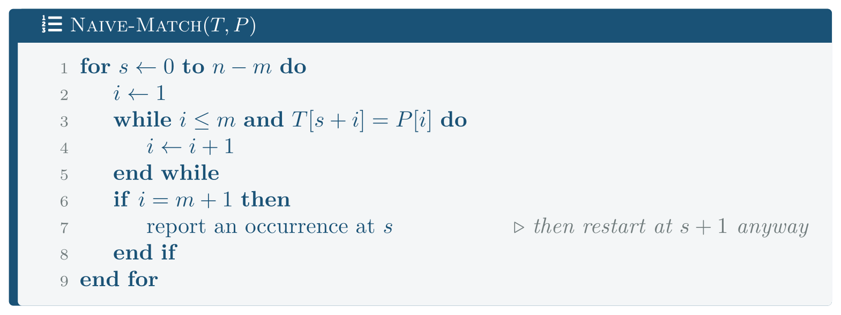
The Problem, and the Obvious Algorithm
FIGURE 21.1
Naive-Match. After a mismatch at shift s it begins again at s+1, re-reading characters it has already examined. That re-reading is the whole of the O(nm).
Analysis of Algorithms · Chapter 21 · String Matching
§21.1 · Handout p. 173 8
Notes:
Figure 21.1 (handout p. 173): Naive-Match. After a mismatch at shift s it begins again at s+1, re-reading characters it has already examined. That re-reading is the whole of the O(nm).

Slide 9

What the naive algorithm forgets
CONCEPT
Suppose P = abcabcd and the first mismatch at shift s occurs at position 7 — so T[s+1 s+6] = abcabc.
The naive algorithm now tries shift s+1, comparing P[1] = a with T[s+2] = b. But we already know T[s+2] = b, because we just read it. Shifts s+1 and s+2 are both hopeless and could have been skipped without looking at the text at all.
The information to skip them is in the pattern, not the text. Both better algorithms exploit this, in different ways: Rabin–Karp summarises the window with a hash, and KMP precomputes exactly how far it may safely jump.
Analysis of Algorithms · Chapter 21 · String Matching
§21.1 · Handout p. 173 9
Notes:
Read the box aloud, then ask for an example from the room before moving on.

Slide 10
Rabin–Karp
SECTION 2 OF 4
21.2
21.1 The Problem, and the Obvious Algorithm
21.2 Rabin–Karp
21.3 Knuth–Morris–Pratt
21.4 Measured
Analysis of Algorithms · Chapter 21
Handout §21.2 10
Notes:
Pause. Name the question this section answers.

Slide 11
Compare numbers, not strings
CONCEPT
Treat each window of m characters as a number in base d modulo q. Then comparing a window with the pattern is one integer comparison rather than up to m character comparisons.
The hash of the next window is computed from the current one in O(1):
— drop the leading character, shift, add the new trailing one. That is why it is a rolling hash.
Unequal hashes prove a mismatch. Equal hashes prove nothing, so every hash match must be verified character by character. A verification that fails is a spurious hit, and the running time is
Analysis of Algorithms · Chapter 21 · String Matching
§21.2 · Handout p. 174 11
Notes:
Read the box aloud, then ask for an example from the room before moving on.

Slide 12

Rabin–Karp inherits every caveat of Chapter 13
WATCH OUT
Its expected O(n+m) assumes spurious hits are rare, which assumes the hash scatters windows well. That is Chapter 13’s simple uniform hashing assumption, with the same two ways to fail: a weak modulus by accident, or a text chosen by an adversary who knows q.
The defence is also the same: a large modulus, and if the input is untrusted, a modulus chosen at random at run time.
Analysis of Algorithms · Chapter 21 · String Matching
§21.2 · Handout p. 174 12
Notes:
Read the box aloud, then ask for an example from the room before moving on.

Slide 13
Knuth–Morris–Pratt
SECTION 3 OF 4
21.3
21.1 The Problem, and the Obvious Algorithm
21.2 Rabin–Karp
21.3 Knuth–Morris–Pratt
21.4 Measured
Analysis of Algorithms · Chapter 21
Handout §21.3 13
Notes:
Pause. Name the question this section answers.

Slide 14
Prefix Function
DEFINITION
For a pattern P of length m, the prefix function π[i] is the length of the longest proper prefix of P[1 i] that is also a suffix of it.
For P = ababaca:
i | 1 | 2 | 3 | 4 | 5 | 6 | 7
P[i] | a | b | a | b | a | c | a
π[i] | 0 | 0 | 1 | 2 | 3 | 0 | 1
π[5] = 3 because aba is both a prefix and a suffix of ababa.
Analysis of Algorithms · Chapter 21 · String Matching
§21.3 · Handout p. 174 14
Notes:
Read the box aloud, then ask for an example from the room before moving on.

Slide 15
Why that is exactly the right shift
CONCEPT
Suppose the pattern has matched k characters and then fails. The matched text is P[1 k]. Any shift that could still succeed must align a prefix of P with a suffix of what has already matched — because that suffix is the only part of the text still under the pattern.
So the next viable shift aligns the longest proper prefix of P[1k] that is also a suffix of it. That is π[k], by definition. Shifting to anything shorter would skip a possible occurrence; shifting to anything longer is impossible.
The text pointer never moves backwards. That single property gives the Θ(n+m) bound, with no hypothesis about the input at all.
Analysis of Algorithms · Chapter 21 · String Matching
§21.3 · Handout p. 174 15
Notes:
Read the box aloud, then ask for an example from the room before moving on.

Slide 16
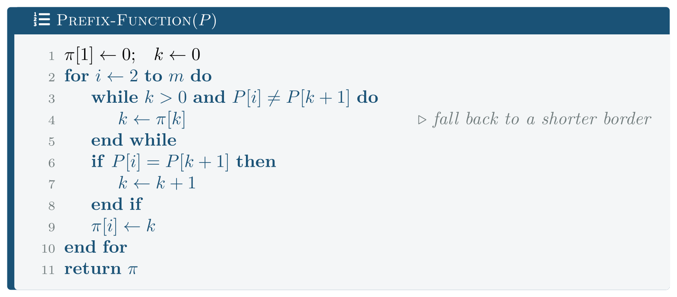
Prefix-Function
FIGURE 21.2
It is KMP run against the pattern itself, and it is Θ(m) by the same amortised argument.
Analysis of Algorithms · Chapter 21 · String Matching
§21.3 · Handout p. 174 16
Notes:
Figure 21.2 (handout p. 175): Prefix-Function. It is KMP run against the pattern itself, and it is Θ(m) by the same amortised argument.

Slide 17
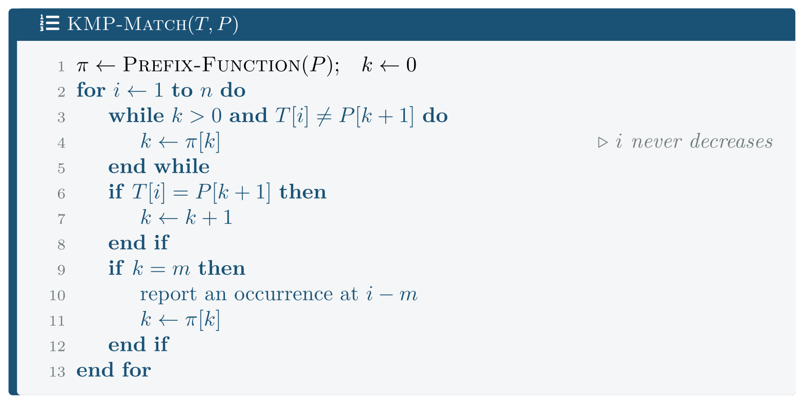
Knuth–Morris–Pratt
FIGURE 21.3
KMP-Match. The text index i advances on every iteration and never retreats, which is what makes the whole thing linear.
Analysis of Algorithms · Chapter 21 · String Matching
§21.3 · Handout p. 174 17
Notes:
Figure 21.3 (handout p. 175): KMP-Match. The text index i advances on every iteration and never retreats, which is what makes the whole thing linear.

Slide 18

KMP
THEOREM 21.1
KMP-Match runs in Θ(n+m) time in the worst case.
Analysis of Algorithms · Chapter 21 · String Matching
§21.3 · Handout p. 174 18
Notes:
Proof. An amortised argument, in the pattern of Chapter 17: take the potential Φ = k, the number of characters currently matched. Φ begins at 0, never goes negative, and each iteration of the for loop increases it by at most 1 (line 7). So over n iterations the total increase is at most n. Each iteration of the inner while loop decreases Φ by at least 1, since π[k] < k always. A quantity that rises by at most n in total and never goes below 0 can fall at most n times. So the inner loop executes at most n times in total across the whole run — not n times per iteration. Hence the matching phase is O(n), and the same argument applied to Prefix-Function gives O(m). The Ω(n+m) is immediate since every character is read.

Slide 19
The same looseness as Build-Heap
CONCEPT
The naive bound for KMP is “n iterations, each with a while loop that could run m times, so O(nm)”. That is correct and badly loose, for exactly the reason Chapter 12’s Build-Heap analysis was: it charges every iteration the worst case, and the expensive iterations are paid for by the cheap ones that preceded them.
Three appearances now — Build-Heap, the dynamic array, and KMP — of one idea. If a bound looks like (count) × (worst case) and the expensive operations consume something the cheap ones built up, the bound is probably loose.
Analysis of Algorithms · Chapter 21 · String Matching
§21.3 · Handout p. 174 19
Notes:
Read the box aloud, then ask for an example from the room before moving on.

Slide 20
Measured
SECTION 4 OF 4
21.4
21.1 The Problem, and the Obvious Algorithm
21.2 Rabin–Karp
21.3 Knuth–Morris–Pratt
21.4 Measured
Analysis of Algorithms · Chapter 21
Handout §21.4 20
Notes:
Pause. Name the question this section answers.

Slide 21

First, Do They Agree?
WORKED EXAMPLE
2,000 random texts and patterns over a 4-letter alphabet. Disagreements: 0.
All three return identical lists of occurrences. The naive version is the oracle, as in Chapter 7.
Analysis of Algorithms · Chapter 21 · String Matching
§21.4 · Handout p. 176 21
Notes:
Each click adds one step of the working. Ask for the next number before you reveal it.

Slide 22
Ordinary Text, Where Nothing Happens
WORKED EXAMPLE
Random text over a 4-letter alphabet, m = 8. Comparisons divided by n:
n | naive | Rabin–Karp | KMP | naive (ms)
1,000,000 | 1.333 | 0.000 | 1.250 | 6.7
2,000,000 | 1.334 | 0.000 | 1.250 | 12.8
8,000,000 | 1.333 | 0.000 | 1.250 | 53.7
All three are linear, and the naive algorithm is barely worse than KMP — 1.333 comparisons per character against 1.250. On random text a mismatch arrives after about 1/(1−1/|Σ|) characters, so the naive algorithm almost never re-reads anything.
Rabin–Karp’s column is 0.000 because the hash rejects every window in one integer comparison and the character-comparison counter never moves.
This is the table that makes people think the choice does not matter. It is also the table that any benchmark on English text would produce.
Analysis of Algorithms · Chapter 21 · String Matching
§21.4 · Handout p. 176 22
Notes:
Each click adds one step of the working. Ask for the next number before you reveal it.

Slide 23
The Text That Destroys the Naive Algorithm
WORKED EXAMPLE
T = aaaa…a of length 200,000, and P = aa…ab of length m. Every shift matches m−1 characters and then fails.
m | naive comparisons | /(nm) | KMP comparisons | naive (ms) | KMP (ms)
10 | 1,999,910 | 1.0000 | 399,991 | 3.55 | 0.85
100 | 19,990,100 | 0.9995 | 399,901 | 28.98 | 1.10
1,000 | 199,001,000 | 0.9950 | 399,001 | 279.22 | 0.80
The naive count is exactly nm — the ratio is 1.0000, 0.9995, 0.9950. The worst case is not an upper bound being approached; it is being attained.
KMP’s count is flat at about 2n, independent of m. The pattern got a hundred times longer and KMP did the same work.
At m = 1,000, KMP is 349× faster. And the input is not contrived: runs of repeated characters occur in DNA, in log files, in padded records and in compressed streams.
Analysis of Algorithms · Chapter 21 · String Matching
§21.4 · Handout p. 176 23
Notes:
Each click adds one step of the working. Ask for the next number before you reveal it.

Slide 24
And the Input That Destroys Rabin–Karp
WORKED EXAMPLE
Rabin–Karp’s expected bound assumes spurious hits are rare. Shrink the modulus and watch:
modulus q | spurious hits | comparisons | time (ms)
13 | 153,522 | 204,708 | 53.1
1,009 | 2,007 | 2,917 | 47.6
1,000,003 | 0 | 208 | 47.8
1,000,000,007 | 0 | 208 | 47.8
The verification count explodes a thousandfold and the clock barely moves — 53.1 ms against 47.8. That is worth pausing on, because it is an honest negative result: on random text a spurious candidate is rejected after about 1.3 characters, so a hundred thousand of them cost almost nothing.
Analysis of Algorithms · Chapter 21 · String Matching
§21.4 · Handout p. 176 24
Notes:
Each click adds one step of the working. Ask for the next number before you reveal it.

Slide 25
And the Input That Destroys Rabin–Karp (continued)
WORKED EXAMPLE
The O(nm) bound needs both many candidates and expensive verification. Here is an input with both — T = a^{n}, P = a^{m}, so every window is a genuine match and every verification runs the full m:
m | RK comparisons | /(nm) | RK (ms) | KMP (ms)
10 | 1,999,910 | 1.0000 | 8.48 | 2.02
100 | 19,990,100 | 0.9995 | 40.21 | 2.14
1,000 | 199,001,000 | 0.9950 | 368.07 | 2.28
Exactly nm again, and KMP is 161× faster at m = 1,000.
Analysis of Algorithms · Chapter 21 · String Matching
§21.4 · Handout p. 176 25
Notes:
Each click adds one step of the working. Ask for the next number before you reveal it.

Slide 26
And the Input That Destroys Rabin–Karp (continued)
WORKED EXAMPLE
The first attempt at this experiment used P = a^{m−1} b — the naive algorithm’s worst case — and measured zero comparisons, because that pattern’s hash differs from every window’s and Rabin–Karp rejected all of them instantly. The two algorithms have different worst cases, and assuming they share one was the mistake.
Analysis of Algorithms · Chapter 21 · String Matching
§21.4 · Handout p. 176 26
Notes:
Each click adds one step of the working. Ask for the next number before you reveal it.

Slide 27
Choosing
CONCEPT
Algorithm | Typical | Worst case | Use when
naive | O(n) | O(nm) | m is tiny, the alphabet is large, and the text is not repetitive
Rabin–Karp | O(n+m) | O(nm) | searching for many patterns at once — one pass, one hash set
KMP | Θ(n+m) | Θ(n+m) | a guarantee is needed, or the text is repetitive, or it is streaming
Rabin–Karp’s real advantage is not speed — KMP beats it and has a guarantee. It is that a set of patterns can be matched in one pass by putting all their hashes in a hash set, which neither of the others can do. That generalises to the Rabin–Karp fingerprint used in rsync and in plagiarism detection.
KMP’s real advantage is that the text pointer never moves backwards, so it works on a stream that cannot be rewound — a socket, a pipe, a file too large to hold.
Analysis of Algorithms · Chapter 21 · String Matching
§21.4 · Handout p. 176 27
Notes:
Read the box aloud, then ask for an example from the room before moving on.

Slide 28

Common pitfalls
COMMON PITFALLS
✕
Benchmarking only on English text. Measured, the naive algorithm was within 7% of KMP there and 349× worse on repetitive input.
✕
Assuming two algorithms share a worst case. The pattern that is worst for naive matching made Rabin–Karp do zero comparisons.
✕
Forgetting to verify a Rabin–Karp hash match. Equal hashes do not mean equal strings. Skipping the check makes it fast and wrong.
✕
A small or fixed modulus on untrusted input. Chapter 13’s flooding attack, in a new costume.
✕
Getting π off by one. It is the longest proper prefix that is also a suffix; π[i] < i always, and π[i] = i would make the matching loop hang.
✕
Believing KMP is O(nm) because of the nested while. The amortised argument is the whole point.
Analysis of Algorithms · Chapter 21 · String Matching
§21.4 · Handout p. 176 28
Notes:
For each pitfall, ask who has seen it happen. One real story beats five bullets.

Slide 29
Common pitfalls (continued)
COMMON PITFALLS
✕
Reaching for KMP when std::search will do. For one short pattern in a non-repetitive text, the library is fine and it is already written.
Analysis of Algorithms · Chapter 21 · String Matching
§21.4 · Handout p. 176 29
Notes:
For each pitfall, ask who has seen it happen. One real story beats five bullets.

Slide 30

Try it yourself: Three Algorithms and Two Traps
TRY IT YOURSELF
Reproduces all five tables. Expect thirty minutes.
WHAT YOU WILL DO
1. Naive matching: try every alignment
2. Rabin-Karp: compare numbers, not strings
3. KMP: never re-read a character of the text
4. All three agree, on every input used below
5. Ordinary text, where nothing much happens
6. The text that destroys the naive algorithm
7. The input that destroys Rabin-Karp
8. Rabin-Karp's actual worst case
THIS WEEK'S LAB
WHAT YOU WILL RUN
RUNNABLE COPY
Week 15: Naive, Rabin–Karp and KMP on the same corpus
1 listing, 60 lines of C++
code/ch21_strings.cpp
Analysis of Algorithms · Chapter 21 · String Matching
§21.4 · Handout p. 176 30
Notes:
Reproduces all five tables. Expect thirty minutes.

Slide 31
Three Algorithms and Two Traps
LAB · STEP 1 OF 8
Naive matching: try every alignment
C++ · code/ch21_strings.cpp
1
2
3
4
5
6
// ch21_strings.cpp -- naive, Rabin-Karp and KMP, on text and on traps.
// Build: cl /O2 /EHsc /std:c++17 ch21_strings.cpp (see Appendix A)
// --- 1. Naive matching: try every alignment ------------------------
// After a mismatch at offset s it restarts at s+1, re-reading
// characters it has already looked at. That re-reading is the O(nm).
Analysis of Algorithms · Chapter 21 · String Matching
§21.4 · Handout p. 176 31
Notes:
Step 1: Naive matching: try every alignment. Read the code aloud; ask what each line would print before running it.

Slide 32
Three Algorithms and Two Traps
LAB · STEP 2 OF 8
Rabin-Karp: compare numbers, not strings
C++ · code/ch21_strings.cpp
8
9
10
11
12
13
14
15
16
17
18
19
20
// --- 2. Rabin-Karp: compare numbers, not strings -------------------
// A rolling hash of each window. Equal hashes mean a POSSIBLE match
// that must be verified; unequal hashes mean a certain mismatch,
// decided in one comparison. Expected O(n+m); the worst case is every
// window colliding, which is Chapter 13's problem in a new costume.
if (hp == ht) { // candidate -- verify it
size_t i = 0;
while (i < m) { ++cmps; if (t[s+i] != p[i]) break; ++i; }
if (i == m) hits.push_back(s);
else if (spurious) ++*spurious; // hash agreed, text did not
}
ht = (ht + mod - (high * (unsigned char)t[s]) % mod) % mod;
ht = (ht * base + (unsigned char)t[s + m]) % mod;
Analysis of Algorithms · Chapter 21 · String Matching
§21.4 · Handout p. 176 32
Notes:
Step 2: Rabin-Karp: compare numbers, not strings. Read the code aloud; ask what each line would print before running it.

Slide 33
Three Algorithms and Two Traps
LAB · STEP 3 OF 8
KMP: never re-read a character of the text
C++ · code/ch21_strings.cpp
22
23
24
25
26
27
28
29
30
31
32
33
34
35
36
37
// --- 3. KMP: never re-read a character of the text -----------------
// pi[i] is the length of the longest proper prefix of p[0..i] that is
// also a suffix of it. On a mismatch, that is exactly how far the
// pattern can be shifted without missing an occurrence -- so the text
// pointer only ever moves forward, giving O(n+m) with no hypothesis
// about the input at all.
static std::vector<size_t> prefix_function(const std::string& p) {
std::vector<size_t> pi(p.size(), 0);
for (size_t i = 1; i < p.size(); ++i) {
size_t k = pi[i - 1];
while (k > 0 && p[i] != p[k]) k = pi[k - 1];
if (p[i] == p[k]) ++k;
pi[i] = k;
}
return pi;
}
Analysis of Algorithms · Chapter 21 · String Matching
§21.4 · Handout p. 176 33
Notes:
Step 3: KMP: never re-read a character of the text. Read the code aloud; ask what each line would print before running it.

Slide 34
Three Algorithms and Two Traps
LAB · STEP 4 OF 8
All three agree, on every input used below
C++ · code/ch21_strings.cpp
39
// --- 4. All three agree, on every input used below -----------------
Analysis of Algorithms · Chapter 21 · String Matching
§21.4 · Handout p. 176 34
Notes:
Step 4: All three agree, on every input used below. Read the code aloud; ask what each line would print before running it.

Slide 35
Three Algorithms and Two Traps
LAB · STEP 5 OF 8
Ordinary text, where nothing much happens
C++ · code/ch21_strings.cpp
40
41
// --- 5. Ordinary text, where nothing much happens ------------------
// This is the case that makes people think the choice does not matter.
Analysis of Algorithms · Chapter 21 · String Matching
§21.4 · Handout p. 176 35
Notes:
Step 5: Ordinary text, where nothing much happens. Read the code aloud; ask what each line would print before running it.

Slide 36
Three Algorithms and Two Traps
LAB · STEP 6 OF 8
The text that destroys the naive algorithm
C++ · code/ch21_strings.cpp
43
44
45
46
// --- 6. The text that destroys the naive algorithm -----------------
// text = aaaa...a, pattern = aaa...ab. Every alignment matches m-1
// characters and then fails, so the naive version does n*m
// comparisons -- the worst case, reached exactly.
Analysis of Algorithms · Chapter 21 · String Matching
§21.4 · Handout p. 176 36
Notes:
Step 6: The text that destroys the naive algorithm. Read the code aloud; ask what each line would print before running it.

Slide 37
Three Algorithms and Two Traps
LAB · STEP 7 OF 8
The input that destroys Rabin-Karp
C++ · code/ch21_strings.cpp
48
49
50
// --- 7. The input that destroys Rabin-Karp -------------------------
// Shrink the modulus and every window becomes a candidate that must
// be verified. This is Chapter 13's adversarial hashing again.
Analysis of Algorithms · Chapter 21 · String Matching
§21.4 · Handout p. 176 37
Notes:
Step 7: The input that destroys Rabin-Karp. Read the code aloud; ask what each line would print before running it.

Slide 38
Three Algorithms and Two Traps
LAB · STEP 8 OF 8
Rabin-Karp's actual worst case
C++ · code/ch21_strings.cpp
52
53
54
55
56
57
58
59
60
// --- 8. Rabin-Karp's actual worst case -----------------------------
// The pattern a^(m-1)b does NOT do it: its hash differs from every
// window of a^n, so Rabin-Karp rejects all of them in one comparison
// each and never verifies anything. (The first version of this
// program measured exactly zero comparisons, which was the clue.)
//
// The bound needs every window to be a CANDIDATE. Take p = a^m: now
// every window hashes equal, every verification runs the full m
// characters, and the total is n*m.
Analysis of Algorithms · Chapter 21 · String Matching
§21.4 · Handout p. 176 38
Notes:
Step 8: Rabin-Karp's actual worst case. Read the code aloud; ask what each line would print before running it.

Slide 39
What the lab shows
TRY IT YOURSELF
What to notice. Parts 7 and 8 together. Part 7 shows a thousandfold rise in verifications that costs 11% of the running time; part 8 shows the input where the same bound actually bites. A measurement that moves a counter dramatically and the clock barely at all is telling you the counter is not what costs.
Then try to break it. Use KMP to search for all occurrences of 10,000 different patterns in one text, and compare with a Rabin–Karp that puts all 10,000 hashes in a unordered_set and makes a single pass. Predict first. KMP must run 10,000 times; Rabin–Karp runs once. This is the workload where the algorithm with the worse guarantee is the right answer, and it is why Rabin–Karp is still in use.
Analysis of Algorithms · Chapter 21 · String Matching
§21.4 · Handout p. 176 39
Notes:
Read the box aloud, then ask for an example from the room before moving on.

Slide 40

Compute the prefix function for aabaaab and state the shift KMP uses after a mismatch at position 6 (CLO-8).
CHECKPOINT 1 OF 3
Discuss with the person next to you, then advance.
Analysis of Algorithms · Chapter 21 · String Matching
Handout p. 180 · answers in Appendix D 40
Notes:
Ask the room. Do not advance until someone commits to an answer.

Slide 41

Compute the prefix function for aabaaab and state the shift KMP uses after a mismatch at position 6 (CLO-8).
CHECKPOINT 1 OF 3 · ANSWER
For P = aabaaab: π = [0, 1, 0, 1, 2, 2, 3]. (At i=5, aa is a border of aabaa; at i=7, aab is a border of aabaaab.) After a mismatch having matched 6 characters, k π[6] = 2 — the pattern shifts so that its first 2 characters align with the last 2 matched, a shift of 6−2 = 4 positions.
Analysis of Algorithms · Chapter 21 · String Matching
Handout p. 180 · answers in Appendix D 41
Notes:
Answer (Appendix D): For P = aabaaab: π = [0, 1, 0, 1, 2, 2, 3]. (At i=5, aa is a border of aabaa; at i=7, aab is a border of aabaaab.) After a mismatch having matched 6 characters, k π[6] = 2 — the pattern shifts so that its first 2 characters align with the last 2 matched, a shift of 6−2 = 4 positions.

Slide 42
Why does KMP’s inner while loop not make it O(nm)? Give the potential function.
CHECKPOINT 2 OF 3
Discuss with the person next to you, then advance.
Analysis of Algorithms · Chapter 21 · String Matching
Handout p. 180 · answers in Appendix D 42
Notes:
Ask the room. Do not advance until someone commits to an answer.

Slide 43
Why does KMP’s inner while loop not make it O(nm)? Give the potential function.
CHECKPOINT 2 OF 3 · ANSWER
Because the inner loop only ever decreases k, and k is increased by at most 1 per outer iteration. Take Φ = k: it starts at 0, never goes negative, and rises by at most n in total across the run, so it can fall at most n times in total. The inner loop therefore executes at most n times over the whole run, not per iteration — the same amortised argument as Build-Heap and the dynamic array.
Analysis of Algorithms · Chapter 21 · String Matching
Handout p. 180 · answers in Appendix D 43
Notes:
Answer (Appendix D): Because the inner loop only ever decreases k, and k is increased by at most 1 per outer iteration. Take Φ = k: it starts at 0, never goes negative, and rises by at most n in total across the run, so it can fall at most n times in total. The inner loop therefore executes at most n times over the whole run, not per iteration — the same amortised argument as Build-Heap and the dynamic array.

Slide 44
The pattern a^{m−1}b is the naive algorithm’s worst case and makes Rabin–Karp do no work at all. Explain both facts from the algorithms’ structure.
CHECKPOINT 3 OF 3
Discuss with the person next to you, then advance.
Analysis of Algorithms · Chapter 21 · String Matching
Handout p. 180 · answers in Appendix D 44
Notes:
Ask the room. Do not advance until someone commits to an answer.

Slide 45
The pattern a^{m−1}b is the naive algorithm’s worst case and makes Rabin–Karp do no work at all. Explain both facts from the algorithms’ structure.
CHECKPOINT 3 OF 3 · ANSWER
Naive: every alignment matches the m−1 leading a’s and fails on the final b, so each of the n shifts costs m comparisons — the worst case, attained exactly. Rabin–Karp: it never compares characters at all unless the hashes agree. Every window of a^{n} has the same hash, and a^{m−1}b has a different one, so every window is rejected in one integer comparison. The two algorithms fail on different things: naive on long partial matches, Rabin–Karp on hash collisions.
Analysis of Algorithms · Chapter 21 · String Matching
Handout p. 180 · answers in Appendix D 45
Notes:
Answer (Appendix D): Naive: every alignment matches the m−1 leading a’s and fails on the final b, so each of the n shifts costs m comparisons — the worst case, attained exactly. Rabin–Karp: it never compares characters at all unless the hashes agree. Every window of an has the same hash, and am−1b has a different one, so every window is rejected in one integer comparison. The two algorithms fail on different things: naive on long partial matches, Rabin–Karp on hash collisions.

Slide 46

What to take away
CHAPTER SUMMARY
1
Naive matching re-reads text after a mismatch, giving O(nm) worst case and near-linear behaviour on random text.
2
Rabin–Karp compares rolling hashes: O(n+m) expected, with every hash match verified. It inherits all of Chapter 13’s assumptions.
3
KMP’s prefix function gives the exact safe shift, so the text pointer never moves backwards and the bound is Θ(n+m) with no hypothesis about the input.
4
KMP’s bound is proved by an amortised argument with Φ = k — the same looseness that Build-Heap and the dynamic array had.
5
Measured on random text: 1.333 comparisons per character for naive and 1.250 for KMP. The choice looks irrelevant.
6
Measured on T = a^{n}: the naive count was exactly nm and KMP’s was flat at 2n. At m = 1,000 KMP was 349× faster.
Analysis of Algorithms · Chapter 21 · String Matching
Handout p. 180 46
Notes:
Ask the room to say each takeaway before you reveal it.

Slide 47
What to take away (continued)
CHAPTER SUMMARY
7
Measured: a weak Rabin–Karp modulus produced 153,522 spurious hits and cost only 11% more time, because on random text each verification fails immediately. The O(nm) bound needs an input with both many candidates and expensive verification — P = a^{m} gives exactly nm, and KMP is 161× faster.
8
Rabin–Karp’s real advantage is matching many patterns in one pass; KMP’s is working on a stream that cannot be rewound.
Analysis of Algorithms · Chapter 21 · String Matching
Handout p. 180 47
Notes:
Ask the room to say each takeaway before you reveal it.

Slide 48

Quick check 1 of 2
REVIEW · MULTIPLE CHOICE
KMP’s worst-case running time is:
A
Θ(nm)
B
Θ(n lg m)
C
Θ(n+m)
D
Θ(n²)
Analysis of Algorithms · Chapter 21 · String Matching
Handout p. 180 48
Notes:
Take a show of hands for each option before discussing. (The handout does not print MCQ answers.)

Slide 49
Quick check 2 of 2
REVIEW · MULTIPLE CHOICE
In Rabin–Karp, equal hash values mean:
A
a confirmed occurrence
B
a candidate that must be verified
C
a certain mismatch
D
the modulus is too small
Analysis of Algorithms · Chapter 21 · String Matching
Handout p. 180 49
Notes:
Take a show of hands for each option before discussing. (The handout does not print MCQ answers.)

Slide 50
For your notebook
REVIEW QUESTIONS
SHORT
Define the prefix function and explain why it gives the correct shift after a mismatch (CLO-8).
SHORT
Give the amortised argument for KMP’s linear bound.
SHORT
Name the input that defeats the naive algorithm and the input that defeats Rabin–Karp, and say why they are different.
APPLIED
Trace KMP matching ababaca in abababacaba, listing the value of k after each text character.
APPLIED
You must scan a 50 GB log stream, which cannot be rewound, for any of 200 known error signatures. Choose an algorithm (or combination), justify it against this chapter’s measurements, and say what you would check about the signatures first.
Analysis of Algorithms · Chapter 21 · String Matching
Handout p. 180 50
Notes:
Set these for independent study. Model answers are not printed in the handout.

Slide 51
End of Chapter 21
21
NEXT
READ
Chapter 22 — Complexity Classes: P, NP and NP-Completeness
Handout Chapter 21, pages 173–180
THIS WEEK'S LAB
ASSESSMENT
Naive, Rabin–Karp and KMP on the same corpus
Assignment 2 due
Analysis of Algorithms · Chapter 21 · String Matching
51
Notes:
Close. NEXT: Chapter 22 — Complexity Classes: P, NP and NP-Completeness. READ: Handout Chapter 21, pages 173–180. THIS WEEK'S LAB: Naive, Rabin–Karp and KMP on the same corpus. ASSESSMENT: Assignment 2 due.

